Slide 1
Discrete random variables

Slide 2
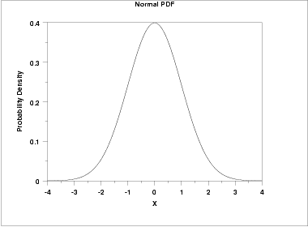
Classifications of random variables
Discrete uniform distribution
Bernoulli distribution
Binomial distribution
Discrete random variables
Poisson distribution
Normal distribution
Random variables
Uniform distribution
Continuous random variables

Slide 3
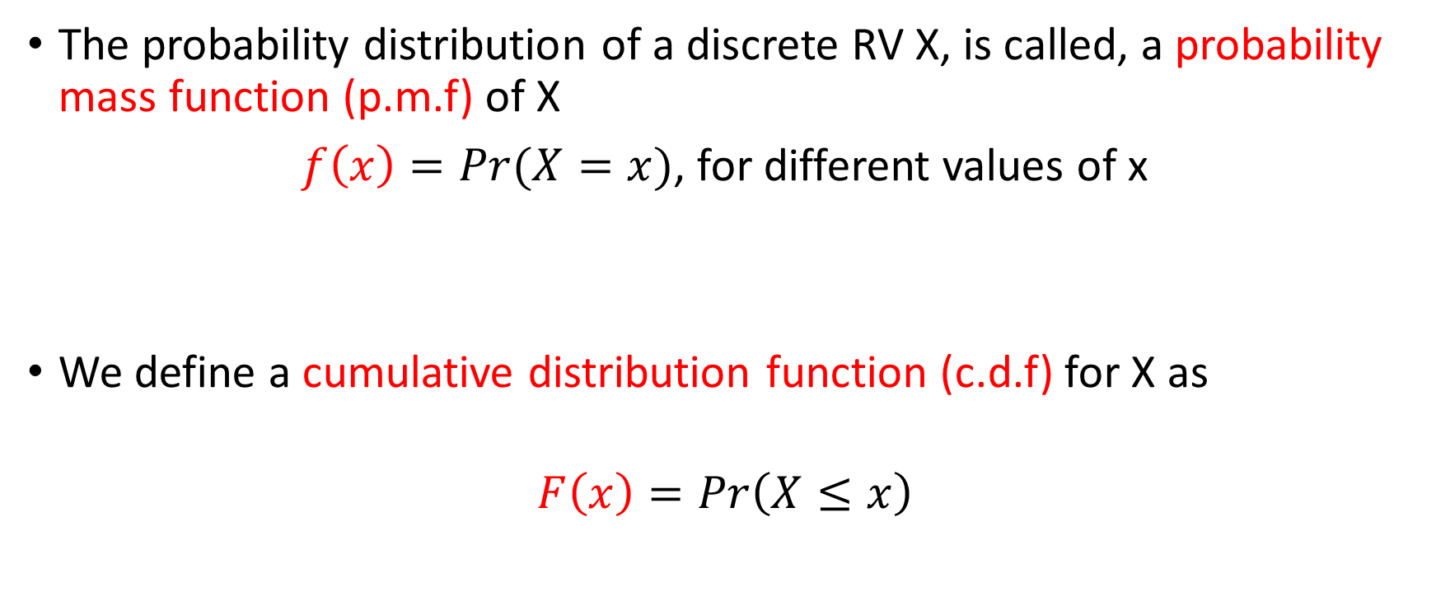
Probabilities for a discrete RV
The probability distribution of a discrete RV X, is called, a probability mass function (p.m.f) of X
$f\left(x\right)=Pr(X=x)$, for different values of x
We define a cumulative distribution function (c.d.f) for X as
$$F\left(x\right)=Pr\left(X≤x\right)$$
For a random variable X, we use Pr(X=x) to denote the probability of X equal to x

Slide 4
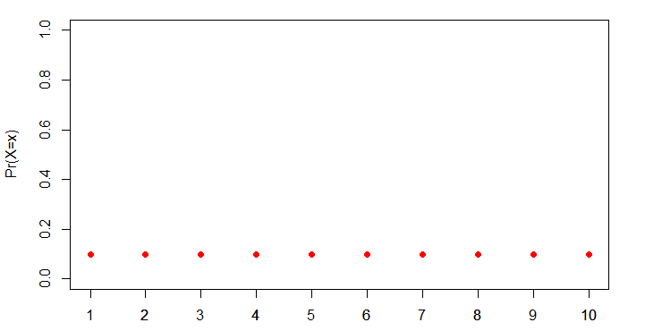
X

Slide 5
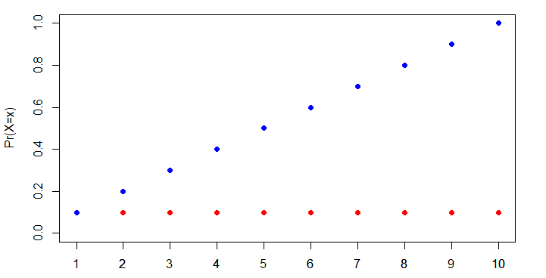
Value of X

Slide 6
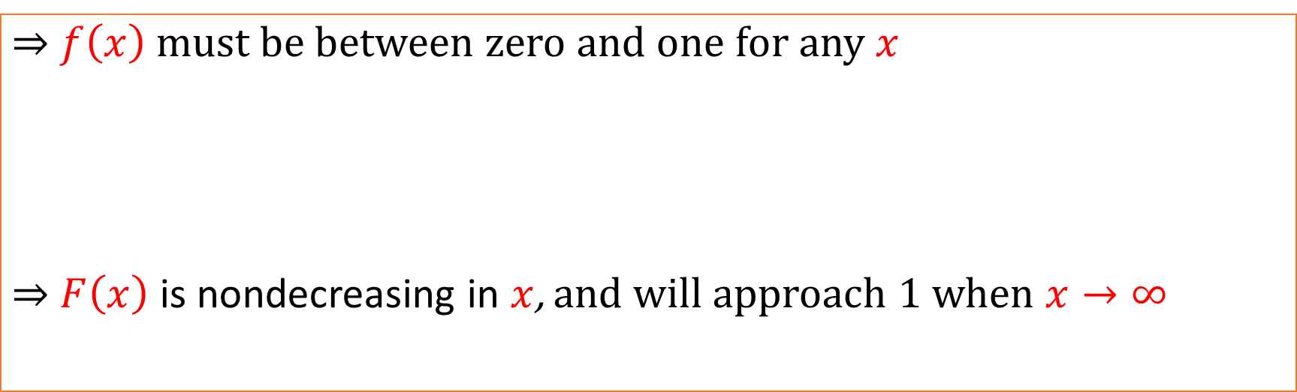
Basic properties of p.m.f. and c.d.f.
$⇒$ $f\left(x\right)$ must be between zero and one for any $x$
$⇒$ $F\left(x\right)$ is nondecreasing in $x$, and will approach 1 when $x→∞$

Slide 7
Discrete probability distributions
Commonly used discrete distributions:
Discrete uniform distribution: multiple values; each with the same probability
Bernoulli distribution: an experiment that has only two possible outcomes
Binomial distribution: an experiment consists of a series of independent Bernoulli trials, the distribution of the number of successes follows a binominal distribution
Poisson distribution: an experiment involves the number of instances over a period of times

Slide 8
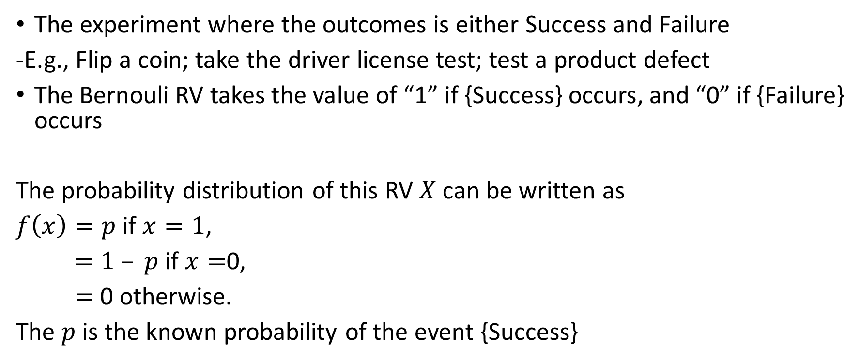
Bernoulli distribution
The experiment where the outcomes is either Success and Failure
-E.g., Flip a coin; take the driver license test; test a product defect
The Bernouli RV takes the value of “1” if {Success} occurs, and “0” if {Failure} occurs
The probability distribution of this RV $X$can be written as
$f\left(x\right)=p$ if $x=1$,
$=1 – p$ if $x=$0,
$=$0 otherwise.
The $p$ is the known probability of the event {Success}

Slide 9
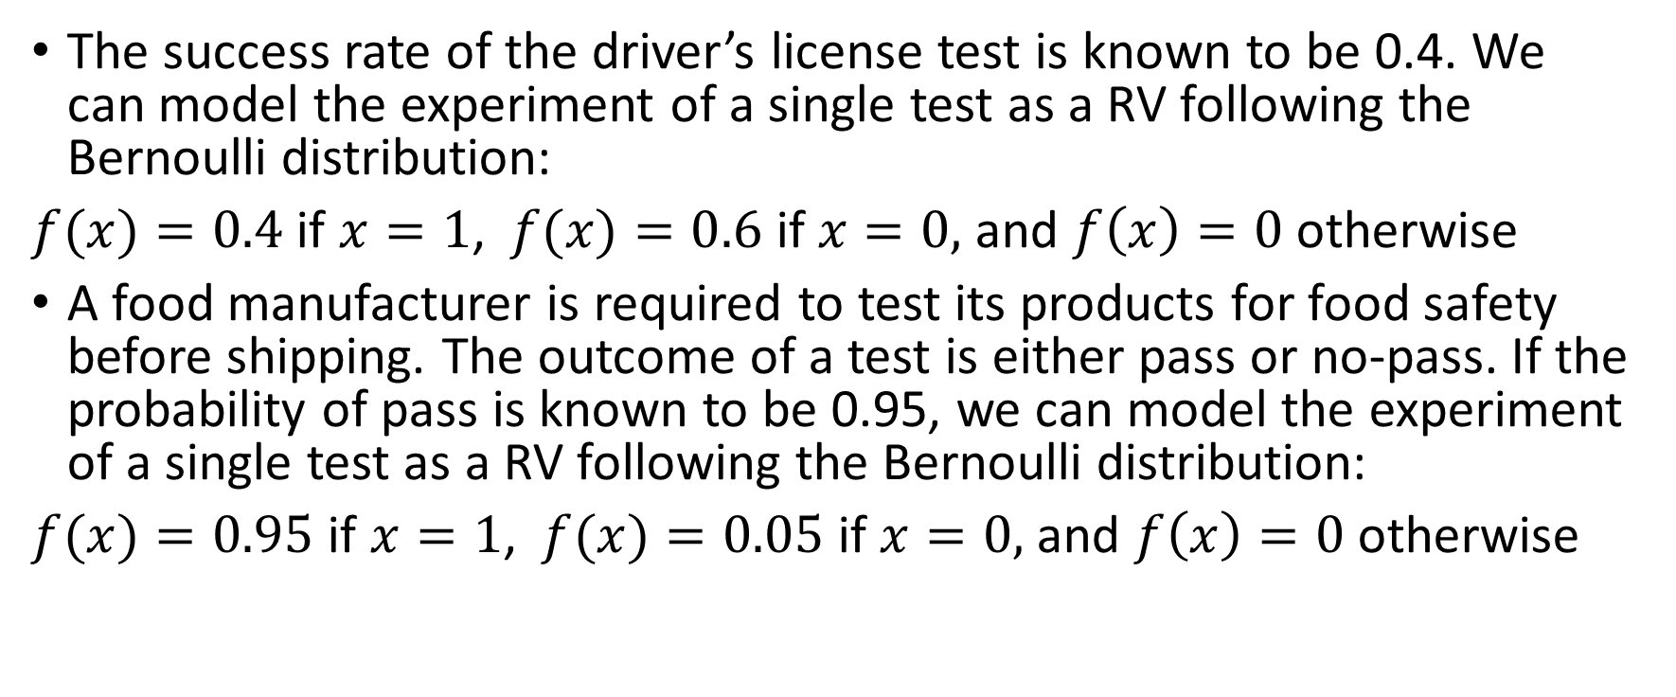
Example: Bernoulli distribution
The success rate of the driver’s license test is known to be 0.4. We can model the experiment of a single test as a RV following the Bernoulli distribution:
$f⁡(x)=0.4$ if $x=1$, $f⁡(x)=0.6$ if $x=0,$ and $f\left(x\right)=0$ otherwise
A food manufacturer is required to test its products for food safety before shipping. The outcome of a test is either pass or no-pass. If the probability of pass is known to be 0.95, we can model the experiment of a single test as a RV following the Bernoulli distribution:
$f⁡(x)=0.95$ if $x=1$, $f⁡(x)=0.05$ if $x=0,$ and $f\left(x\right)=0$ otherwise

Slide 10
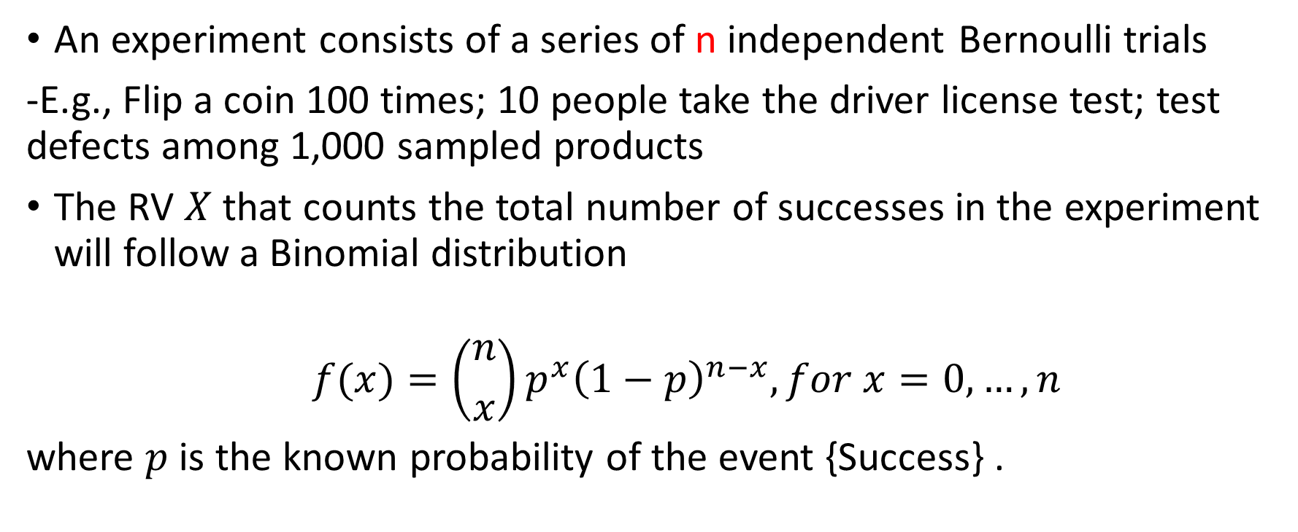
Binomial distribution
An experiment consists of a series of n independent Bernoulli trials
-E.g., Flip a coin 100 times; 10 people take the driver license test; test defects among 1,000 sampled products
The RV $X$that counts the total number of successes in the experiment will follow a Binomial distribution
$$f(x)=\left({n \atop x}\right)p^{x}{\left(1−p\right)}^{n−x}, for x=0,…,n$$
where $p$ is the known probability of the event {Success} .

Slide 11
Binomial distribution
An experiment consists of a series of n independent Bernoulli trials
-E.g., Flip a coin 100 times; 10 people take the driver license test; test defects among 1,000 sampled products
The RV $X$that counts the total number of successes in the experiment will follow a Binomial distribution
$$f(x)=\left({n \atop x}\right)p^{x}{\left(1−p\right)}^{n−x}, for x=0,…,n$$
where $p$ is the known probability of the event {Success} .

Slide 12
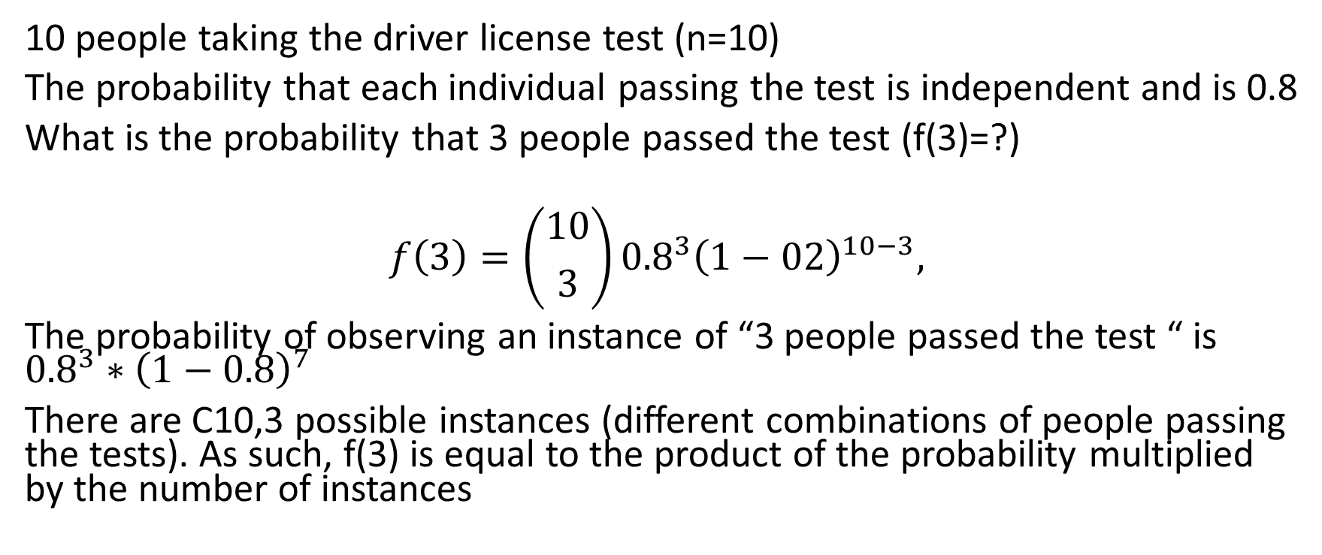
Binomial distribution
10 people taking the driver license test (n=10)
The probability that each individual passing the test is independent and is 0.8
What is the probability that 3 people passed the test (f(3)=?)
$$f\left(3\right)=\left({10 \atop 3}\right){0.8}^{3}{\left(1−02\right)}^{10−3},$$
The probability of observing an instance of “3 people passed the test “ is ${0.8}^{3}∗{\left(1−0.8\right)}^{7}$
There are C10,3 possible instances (different combinations of people passing the tests). As such, f(3) is equal to the product of the probability multiplied by the number of instances

Slide 13
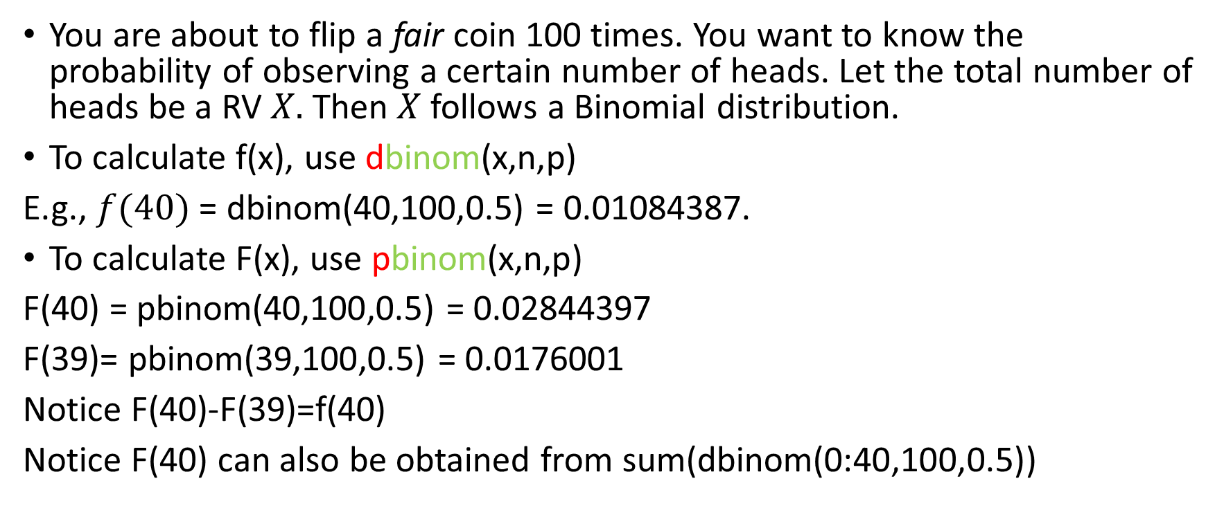
Examples: Binomial distributions
You are about to flip a fair coin 100 times. You want to know the probability of observing a certain number of heads. Let the total number of heads be a RV $X.$ Then $X$ follows a Binomial distribution.
To calculate f(x), use dbinom(x,n,p)
E.g., $f⁡(40)$ = dbinom(40,100,0.5) = 0.01084387.
To calculate F(x), use pbinom(x,n,p)
F(40) = pbinom(40,100,0.5) = 0.02844397
F(39)= pbinom(39,100,0.5) = 0.0176001
Notice F(40)-F(39)=f(40)
Notice F(40) can also be obtained from sum(dbinom(0:40,100,0.5))

Slide 14
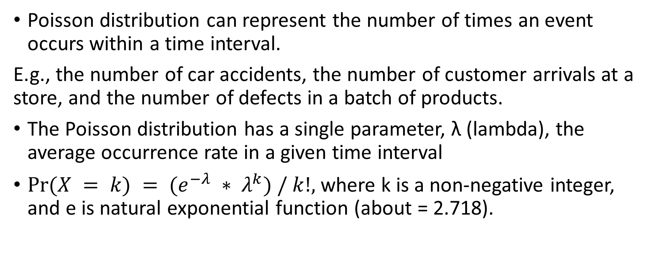
Poisson distribution
Poisson distribution can represent the number of times an event occurs within a time interval.
E.g., the number of car accidents, the number of customer arrivals at a store, and the number of defects in a batch of products.
The Poisson distribution has a single parameter, λ (lambda), the average occurrence rate in a given time interval
$Pr⁡(X = k) = (e^{−λ} ∗ λ^{k}) / k!,$where k is a non-negative integer, and e is natural exponential function (about = 2.718).

Slide 15
Conditions for Poisson distribution
The event occurrences should not be strongly dependent
E.g., customers arrival should be “random”
2. The average rate should be a constant
E.g., cannot use the same rv for both peek-hour and off-peak hour traffic
3. Two or more events cannot happen at the same time

Slide 16

Conditions for Poisson distribution
The event occurrences should not be strongly dependent
E.g., customers arrival should be “random”
Store
Make my own decision? Or see whether others enter or not

Slide 17
Conditions for Poisson distribution
The event occurrences should not be strongly dependent
E.g., customers arrival should be “random”
2. The average rate should be a constant
E.g., cannot use the same rv for both peek-hour and off-peak hour traffic
3. Two or more events cannot happen at the same time

Slide 18
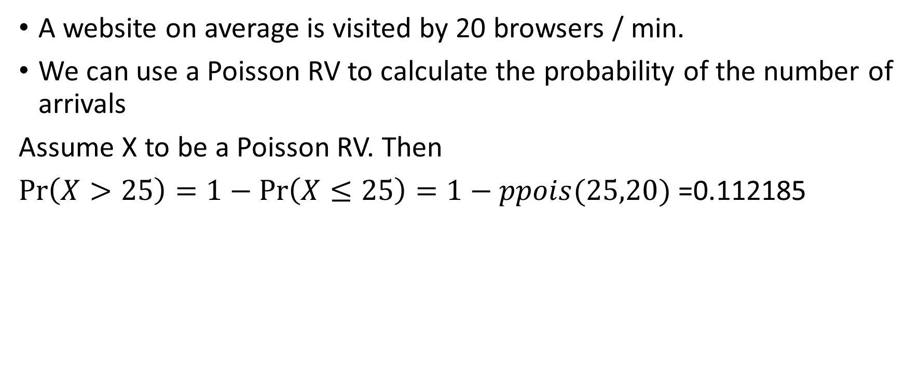
Examples: Poisson distributions
A website on average is visited by 20 browsers / min.
We can use a Poisson RV to calculate the probability of the number of arrivals
Assume X to be a Poisson RV. Then
$\operatorname{Pr}\left(X>25\right)=1−\operatorname{Pr}\left(X≤25\right)=1−ppois(25,20)$=0.112185

Slide 19
Summary
The probability mass function (f(x)) and distribution function (F(x))
Three common discrete RV’s
R commands to calculate pmf and cdf

